Slide 1

BANK CUSTOMER CHURN PROJECT
Agnesa Percuku Gerxhaliu
Alejandra Delgado

Slide 2
CONTENT OF THE PRESENTATION
1. Introduction to our dataset
2. Exploratory Data Analysis
3. Feature Selection
4. Data Preprocessing
5. The Model Selection
6. Feature Importance
5. Conclusions and Recommendations

Slide 3
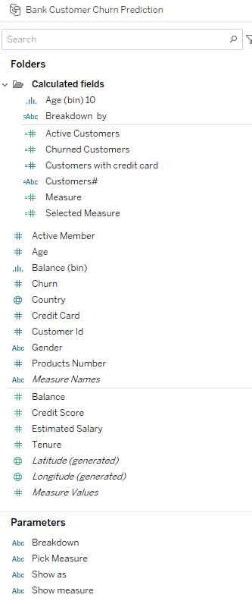
Bank Churn Prediction Dataset

Slide 4

THE QUESTIONS THAT WE WANTED TO ANSWER
How many customers does the bank have?
Who are our customers? Where do they come from?
What is the churn rate among our customers?
Can we categorize customers that are in risk to churn? Which information are mostly related to churn?
Who are customer the customers that churn? What are their characteristics?
What is the mean seniority of the customers in the bank (tenure)?
Which are the profile of the churn customers?
Which are the most important characteristics for customer that are leaving the bank?
Which are the range of age with more Churn?

Slide 5
Handling outliers using quartiles
Transforming categorical values using different encoders
Defining the scalers that will be used in the models
Data
Preprocessing

Slide 6
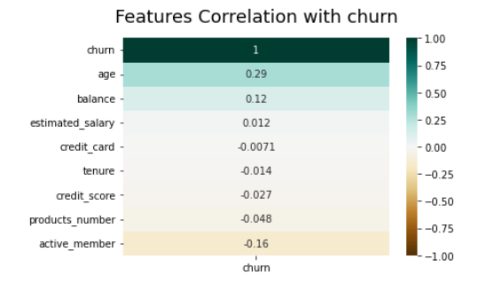
FEATURE SELECTION
The highest correlations that we can see from this
matrix is between:
churn and age
churn and balance

Slide 7
Models that are used:
Logistic regression
KNeighbors Classifier
Decision Trees
Random Forest
Polynomial Encoder
F1 Score=56%
MinMaxScaler
F1 Score= 61%
min_samples_leaf=50
F1 Score= 71%
n_estimators=200
class_weight: {0:1, 1:4}
F1 Score=77%
class_weight: {0:1, 1:4}
n_neighbors = 3
F1 Score: 62%
class_weight: {0:1, 1:4}

Slide 8
THE MODEL THAT PERFORMED THE BEST
Hyperparameters Tuning
Impact of Outliers
Impact of Split Train Test
Impact of Imbalance
F1 Score=75%
30% vs 20%
F1 Score=75%
F1 Score= 61%
class_weight: {0:1, 1:4}
F1 Score: 76%
criterion: entropy (or measure of disorder)
n_estimator = 200
F1 Score = 77%

Slide 9
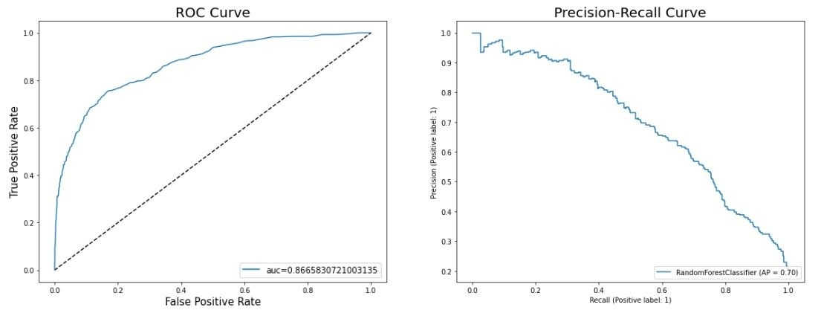
ROC CURVE WITH THE FINAL MODEL
In this case we have a very imbalanced dataset and then we rely on the precision-recall curve, which shows the trade-off between precision and recall of our model. In fact, we see that the ROC curve presents a rather optimistic view on the performance of the model (high area under the curve) while the precision-recall doesn't.

Slide 10
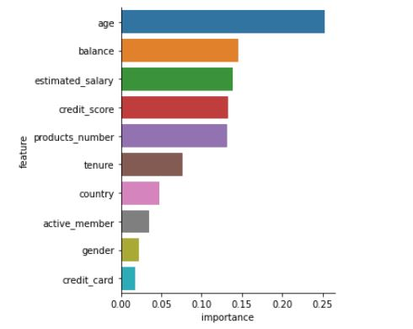
Feature Importance
Based on the sum of the feature importances of the individual Decision trees
Age
Balance
Credit Score and products number
…
Credit_Card

Slide 11
CONCLUSION AND RECOMMENDATIONS
Now we have a good understanding of the customers and churn. We also have a good way to classify customers that churn so the bank can take measures to prevent them from churning.
Adding time related data would be interesting. With that data, we can study the behavior of customers over time and get more insights out of it.
Further study on why females and Germans tend to churn more are needed.
Adding other features can also help to understand Churn more.

